Slide 1
Bankruptcy Prediction Modelling
MGMT 571- Data Mining
Team: Mine Sweepers
Aryan Saxena
Himanshu Sharma
Jayesh Chaudhari

Slide 2
Exploratory Data Analysis – A starting point
EDA Insight | Description
No Missing Values | Data had no missing values, allowing seamless analysis without imputation – Great News!
Outliers | Significant outliers identified; required handling or robust models.
Skewed Attributes | Highly skewed attributes needed transformation for simpler models like logistic regression. Models like Gradient Boosting or Neural Networks might be better suited due to their flexibility.
Collinearity | Addressed using regularization techniques like LASSO.
Imbalanced Target Variable | Skewness in target variables, addressed using ensemble methods.
The EDA provided us with a robust foundation to begin our modelling exercise

Slide 3



Modelling – An iterative and additive process
Baseline Models
Ensemble Model 1
Ensemble Model 2
Methodology:
Partitioned the train data – 60:40
Tried the following models:
Logistic Regression
Decision Trees
Neural Networks
Polynomial Logistic Regression
Methodology:
Partitioned the train data – 60:40
Used an Average Ensemble of the following:
Polynomial Logistic Regression
Lasso Regression
Neural Networks
Gradient Boosting
Methodology:
Partitioned the train data – 70:30
Tweaked the Neural Net for classification:
Adjusted Model Selection Criterion to Misclassification
Decreased hidden units to 8
Activation function – Logistic
Error function – Bernoulli
Results:
Test Data Accuracy: 88 – 90%
Results:
Test Data Accuracy: 90 - 92%
Results:
Test Data Accuracy: ~93%
Inference:
Each individual model was not performing well – why not ensemble?
Inference:
Ensembles aid to better fit. However, preprocessing was leading to overfitting.
Inference:
Tweaking the models marginally improved performance, there was scope for more…
Challenge: After tweaking our model, we found accuracy to be close to 93%, which left room for improvement

Slide 4
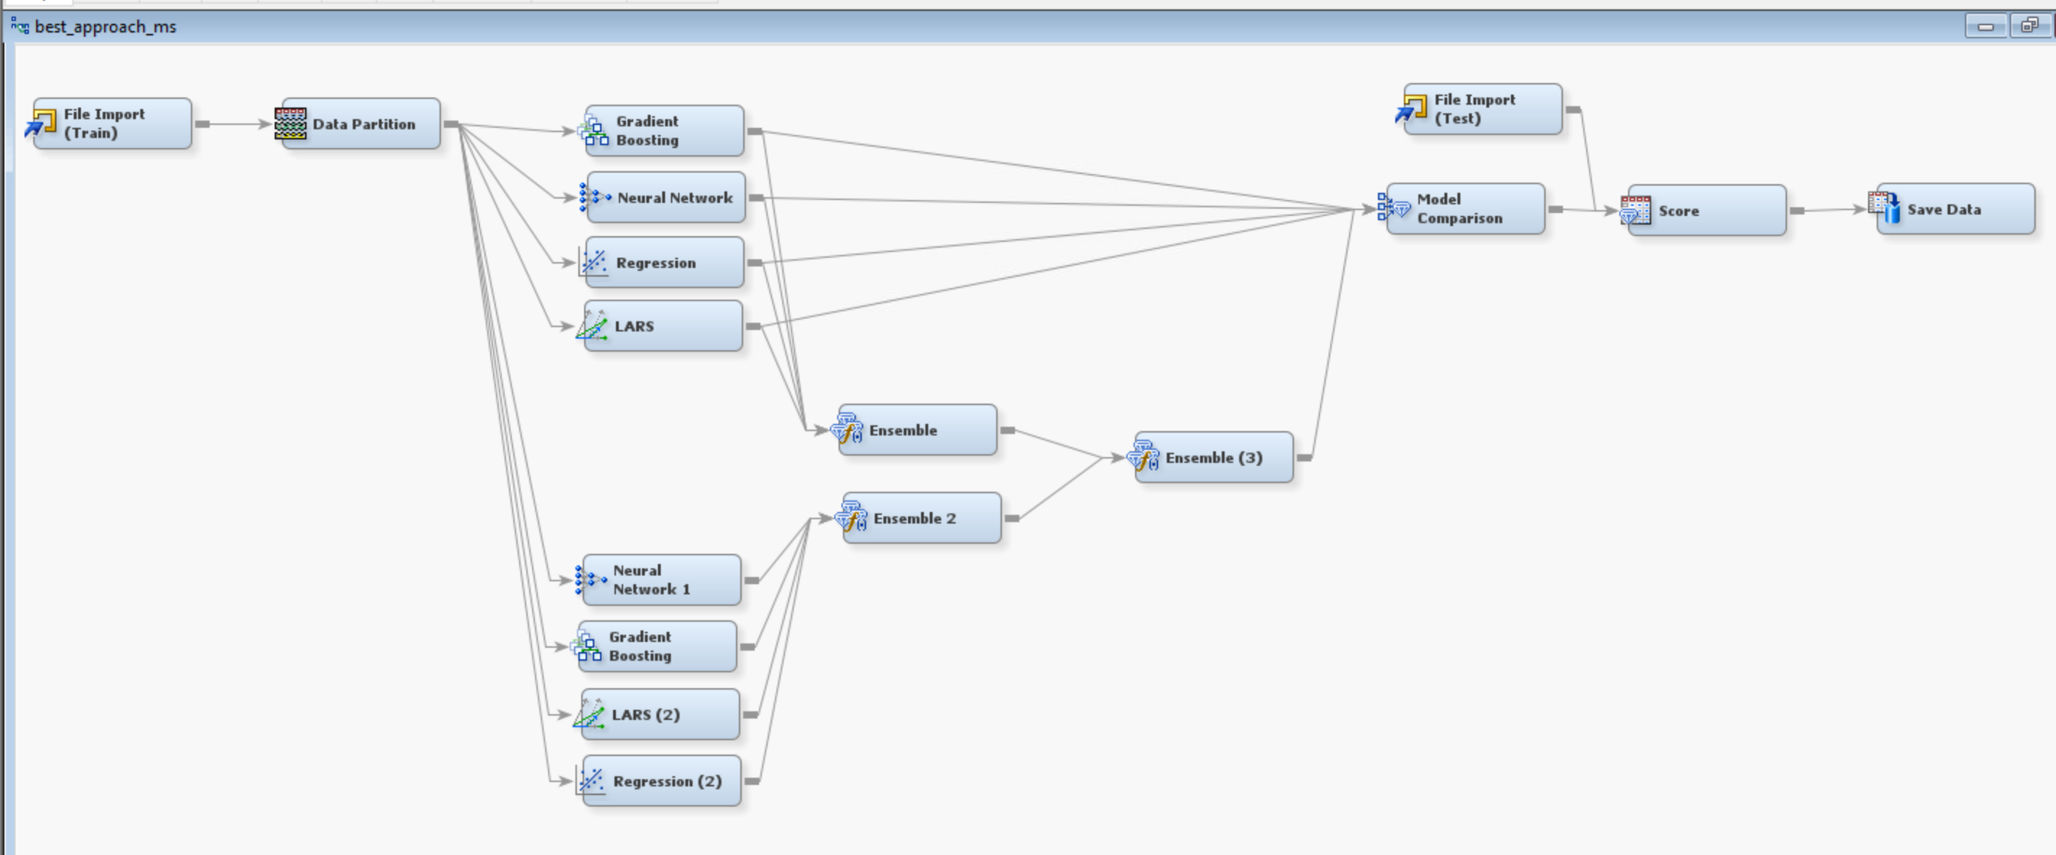
Final Model: An Ensemble of our 2 best Ensembles
Idea: Ensemble-ception – Taking an average ensemble of our two best models, this should increase our test accuracy
Model Details
Why we believe this approach worked
Model 1 was pretty barebones; its core idea was to combine models in their default settings into one ensemble to handle for data balance issues
Model 2 focused on improving accuracy by making changes to the parameters; however, in achieving this, it led to a slight overfitting problem
Stacking the two models together took the best of both worlds and improved model 1’s accuracy while solving for model 2’s overfitting
Model 1
Model 3 – Our Best!
Model 2
Results: After running this model, we achieved our best accuracy – 94.15% on the private leaderboard test data
Notes:
Model 2 was over fitting, to prevent it to overfit on test data we decided to add the previous model.

Slide 5
Learnings
Key Learning | Insight
EDA and Model Alignment | Integrating EDA insights with model strengths leads to optimal performance.
Regularization Techniques | LASSO effectively addresses collinearity, improving model robustness.
Handling Skewed/Outlier Data | Gradient Boosting and Neural Networks perform well with skewed and outlier-prone data.
Ensemble Methods | Combining diverse models improved accuracy and overall predictive power.
Over-engineering pitfalls | Excessive feature engineering led to overfitting, reducing model generalizability.
Conclusion: We should listen to Christopher Nolan and OpenAI more often (look-up “Inception” on ChatGPT)

